Slide 1
A Brief Introduction to React
By Saqif Abrar

Slide 2
Prerequisites
Fundamental understanding to
- HTML
CSS
JavaScript (ES6)
An IDE
Please have Node.js installed and Node Package Manager (npm)

Slide 3
Introduction
React.js is a free and open-source library, used to build the front-end of user interfaces. Many websites (and even apps) that you see and interact with today are built with React.

Slide 4

History
The start of React can be boiled down to the start of JavaScript. Invented by Brenden Eich in 1995, JavaScript worked on the Netscape browser and allowed for static pages.
When the AJAX API released in 2005, it allowed for websites to send and request data from the server without having to refresh the web page, allowing for more dynamic and robust features from websites.

Slide 5
History (cont’d)
The story continues as jQuery and Angular.js were built around the concept of manipulating and managing the Document Object Model (DOM). Earlier versions were clunky, and it was generally harder for other kinds of developers (such as back-end developers) to develop on the front-end. Also, early stage DOM manipulation lead to more difficult to manage situations.

Slide 6

History (finale)
That’s when Jordan Walke, the inventor of React.js, and people in the React team designed a solution to this problem. The idea was to complete re-ren
der the view from scratch whenever there was a change in data. They also tied HTML, CSS and JavaScript into one bundle to make it easier for development, calling the “newfound language” JavaScript Expressions, also known as JSX.

Slide 7
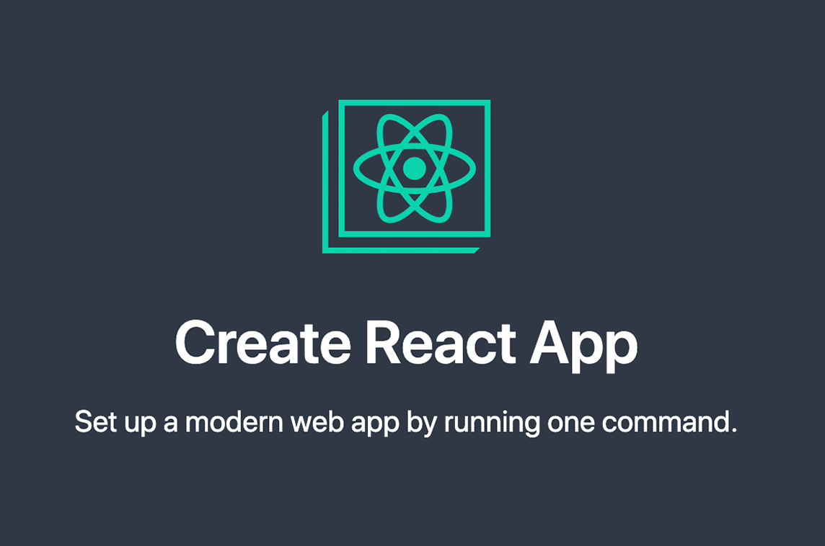
Getting Started
create-react-app
To create a React web application, we start start by creating a simple default, and barebones project by calling the following command in the terminal:
- npx create-react-app

Slide 8

Intro React Resources
Because React has been around for a longer time and is very popular, it has wonderful documentation online and a vast community that can help you grow. I highly recommend looking at the ReactJS documentation and this article recommended by the React team.
React Documentation
https://reactjs.org/docs/getting-started.html
React Tutorial: An Overview and Walkthrough by Tania Rascia
https://www.taniarascia.com/getting-started-with-react/

Slide 9
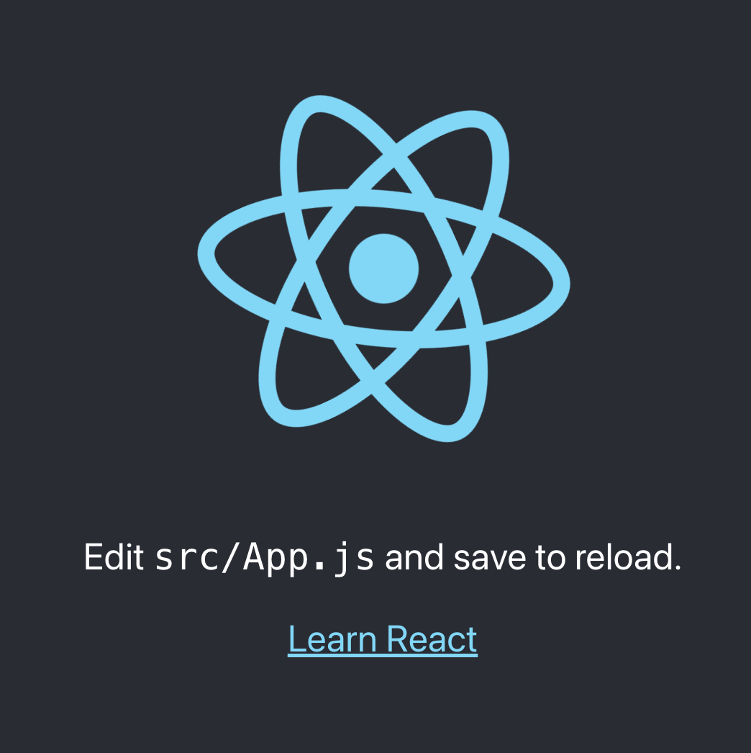
Getting Started (cont’d)
In your terminal, type the following command
npm start
Then you should go to your browser and type localhost:3000 in the search bar
You should be greeted by a page that looks like this

Slide 10
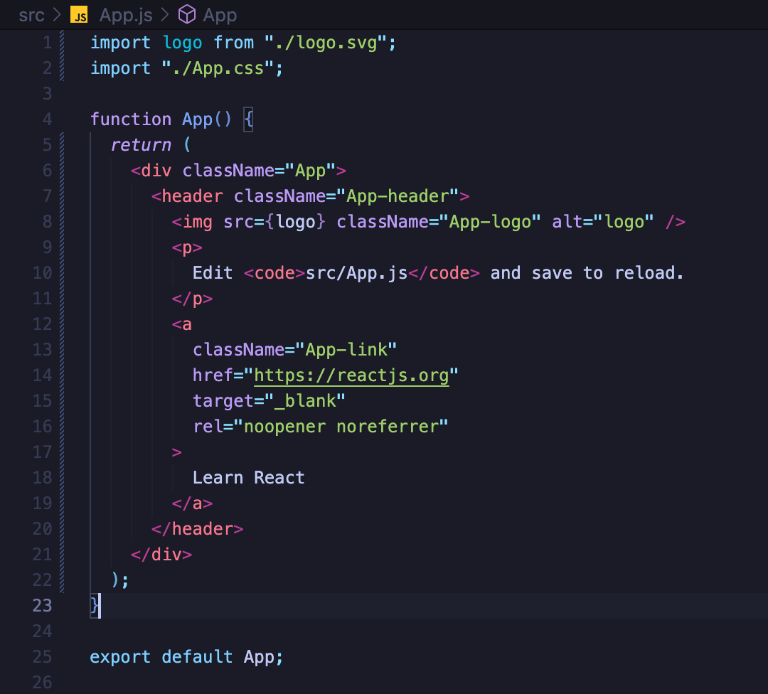
Getting Started (finale)
Let’s take a look at how the default page is built!
When we dive into App.js we can see all the HTML elements that compose the default page. This is our App component.
But how does everything get rendered on the web?

Slide 11
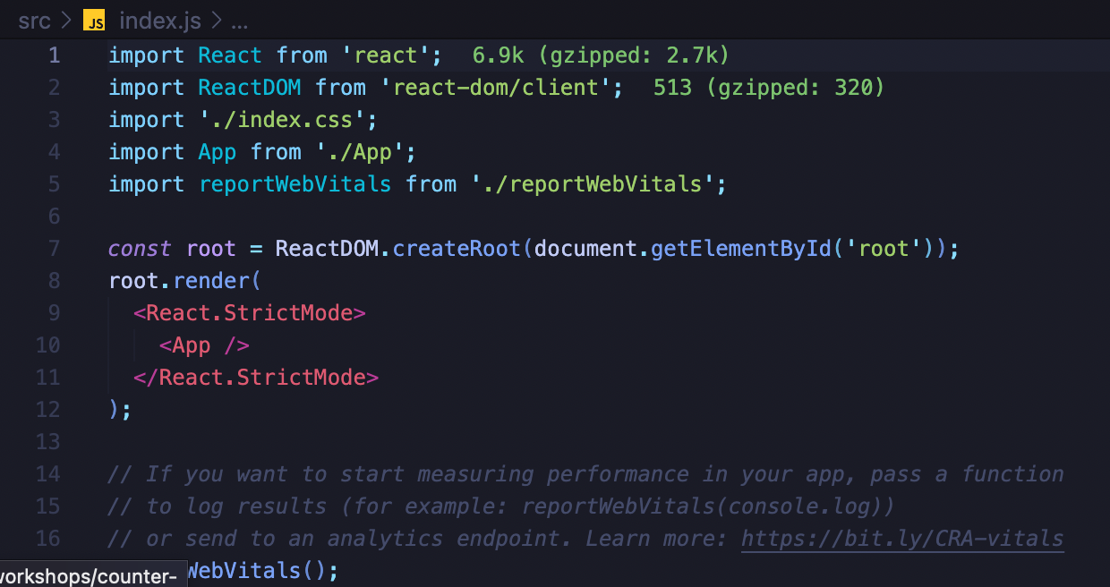
Components
We start at index.js where you see App component is imported and is used with <App> as a child of another component <React.StrictMode>.
These are passed into the function, ReactDOM.render() where it will render rom the root of the page.

Slide 12
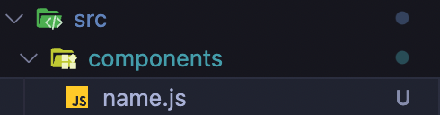
Components (cont’d)
Let’s create another component.
Under the ./src directory, create another directory called “components”
Let’s create a file called “name.js” where we’ll create just put a header that says, “My name is <insert your name here>”.

Slide 13

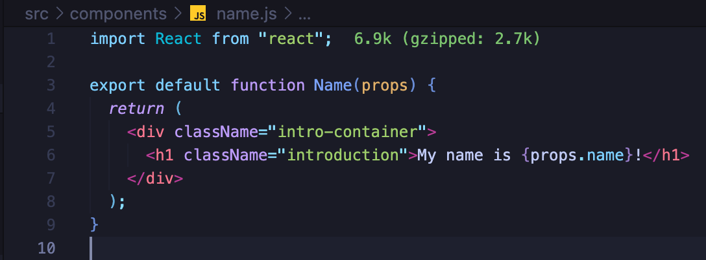
Components (finale)
When we create JSX elements, all properties should be in camel notation.
- Let’s give the h1 a className of “introduction”
Finally, we’ll import it as a component inside our app component in app.js right above the img element.

Slide 14
Deeper Dive into JSX
We’ve learned that React organizes itself into functional components that returns JSX values to be rendered on the DOM. But we’re using HTML inside JavaScript, so what really is JSX?
Essentially,
<h1 className=“introduction”>My name is Bob</h1>
Is this...
React.createElement(“h1”, {className: “introduction”}, “My name is Bob”);

Slide 15
Deeper Dive into JSX (finale)
However, our HTML tree often than not, will always be large, so by invoking the createElement method may get a little messy. The h1
React.createElement(“div”, {className: “intro-container”},
React.createElement(“h1”, {className: “introduction”}, “My name is Bob”));
JSX was designed to avoid this messiness and complexity and merge HTML and JavaScript together for a smoother workflow.

Slide 16
Passing Props
What if we want to dynamically change the names? Well, we can pass the name through a property and use that value in our name component.

Slide 17
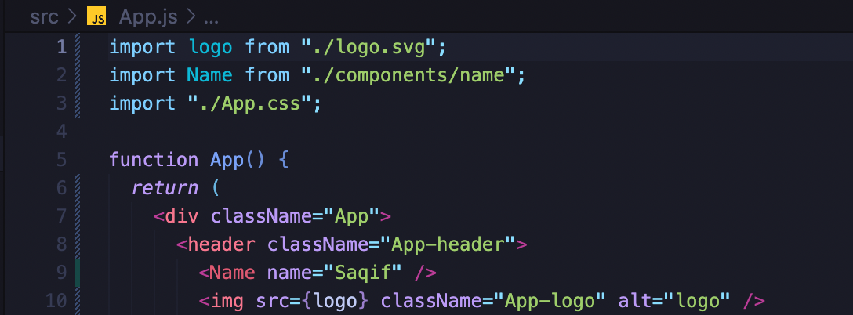
Passing Props (finale)
We can use that prop anywhere by calling {props.propName} in our function.
We’ll use the property name called “name” and assign it a value of our name in our name component we imported in app.js
We’ll finally call {props.name} where we want to insert our name in our h1 tag.

Slide 18
Passing Props Tip
Using Ecma Script 6 (ES6), we can use object destructuring and where we can use the name of our property directly as a variable in our functional component.
<MyComponent name=“Bob” age=6/>
export default function MyComponent({ name, age }) {
const text = Bob + “ is ” + age + “ years old! ”; // “Bob is 6 years is old!”
…
)

Slide 19

Useful JavaScript for React Resources
React is powerful with many JavaScript functions and ES6 features. I highly recommend you check them out because you will be using them frequently in your React journey and it’ll make programming easier.
Top 10 ES6 Features Every Javascript Developer Must Know by Kavisha Talsania
https://medium.com/@kavisha.talsania/top-10-es6-features-every-javascript-developer-must-know-4c81ec54bbcd
The JavaScript Skills You Need For React (+ Practical Examples) by Reed Barger
https://www.freecodecamp.org/news/javascript-skills-you-need-for-react-practical-examples/
**(some of the features/functions may overlap)

Slide 20
Creating a New App
Let’s clean out all the content inside app.js to start fresh. In this app, we’ll create a counter application where you can increase and decrease the counter. It will involve a the useState hook which should be an introduction to state management, and it should look something like this.

Slide 21

Creating the Counter Component
Requirements:
- A name
- An increment & decrement button
- A display for the number count

Slide 22

useState Hook
A state in React.js is a modifiable object that is used to contain data/information about components.
In our case, we want a state to store our counter.
For now, we’ll create a state in our counter component by invoking the useState React Hook that allows you to create and manipulate a state.
const [counter, updateCounter] = useState(0);

Slide 23

useState Hook (cont’d)
We can update the state by creating custom functions that can be called by specific events.
In our case, we’ll use the onClick event to invoke incrementCount and decrementCount functions on the respective button elements.

Slide 24

useState Hook Resources
Highly recommend you watch these for more in-depth info
Learn useState In 15 Minutes - React Hooks Explained - Web Dev Simplified
https://www.youtube.com/watch?v=O6P86uwfdR0
Full React Tutorial #8 - Using State (useState hook) - The Net Ninja
https://www.youtube.com/watch?v=4pO-HcG2igk
ReactJS Documentation
https://reactjs.org/docs/hooks-state.html

Slide 25
Modifying our App
The problem now occurs when we have multiple counters to keep track of. Let’s say we want to count the number of times our friends says something stupid. We have two problems:
1. We don’t want to copy and paste the counter component for all the friends we have.
2. We don’t want our state to be scrambled into little pieces where we have a 1 state per counter

Slide 26

Modifying our App
Q: What’s the solution?
A: Collect all the individual states into 1 state that can be used anywhere.
Q: How do we do this?
A: We use React contexts.

Slide 27
Modifying our App
Before we start developing, let’s plan how we’re going to start developing. Let’s build a component structure.
<App>
All the names and counter information will be centralized in one state here
<FriendsList>
<Friend>

Slide 28
useContext Hook
The useContext allows use to neatly store the state of the component and all that information of the state can be passed down into the components that need the information of the state.
We create contexts in separate files (ex. FriendContexts.js).
Create a context with the createContext() function.
export const FriendsContext = createContext();

Slide 29
useContext Hook (cont’d)
Then create a provider function that “provides” the state information (created by the useState() function).
export const FriendsProvider = props => {
const [friends, setFriends] = useState([
{ name: Saqif, count: 0},
{ name: Rithik, count: 0},
{ name: Zaza, count: 0}])
…
}

Slide 30
useContext Hook (cont’d)
Finally, we can apply this context to all the components that need information from the state.
export const FriendsProvider = props => {
…
return (
<FriendContext.Provider value={[friends, setFriends]}>
<FriendList>
<OtherComponents>
</FriendContext.Provider>
);
}
{props.children}
(can be simplified to)

Slide 31
useContext Hook (finale)
Finally, we can use apply this context to all the components that need it in our app.
import FriendProvider from “../contexts/FriendContext.js”;
function App() {
return (
<FriendProvider>
<FriendsList>
<OtherComponents>
</FriendProvider>
);
}

Slide 32
Modifying our App
Before we start developing, let’s plan how we’re going to start developing. Let’s build a component structure.
<App>
<FriendsProvider>
We’ll use the built-in JavaScript function map() to display our friends with our state
<FriendsList>
We’ll display the individual friend and call our increment/decrement functions that were passed as props
<Friend>

Slide 33
useContext Hook Resources
Highly recommend you watch these for more in-depth info
React State Management Tutorial | Context Api | React Tutorial For Beginners – Dev Ed
https://www.youtube.com/watch?v=35lXWvCuM8o
Learn useContext In 13 Minutes – Web Dev Simplified
https://www.youtube.com/watch?v=5LrDIWkK_Bc
React Hooks useContext Tutorial (Storing a User) - Ben Awad
https://www.youtube.com/watch?v=lhMKvyLRWo0
ReactJS Documentation
https://reactjs.org/docs/hooks-reference.html#usecontext

Slide 34

Some Drawbacks
React is very powerful and makes building for more complex tasks for the web easier than vanilla HTML/CSS/JS. However, it has its drawbacks.
It renders on the client side, state management can be troublesome at times, routing can be frustrating, the learning curve is a little high, it’s a little large for a library and there are more to be listed.

Slide 35
Next Steps
There are many frameworks and libraries that build on top of or work with React that make it even more powerful and I hope you find the time and joy to explore them when you become a React master.
Here are some of my favourites…
Node.js
Create a backend for your front-end!
Next.js
Allows for server-side rendering, image optimization, built-in and easy routing, and many more features
Redux
Popular state management system that helps you co-ordinate states across your React App
Remix
Created by the React-Router-DOM team, is another framework that shares some features with Next.js
React Native
A react library to write apps for android, iOS and the web

Slide 36
Other Steps
Front-end development requires a wide array of knowledge that can be drawn out to build aesthetic, user-experienced oriented and/or just generally fantastic websites.
Some tools I recommend learning is…
Sass
A CSS compiler that allows for useful features like mixins with a small learning curve and powerful tools
Tailwind CSS
Works well with component-based libraries/frameworks for quick, intuitive and easy CSS development
Framer Motion
A fantastic animation library that is relatively easy to use to make complex and unique animations
Three.js
Great graphics library that help you create stunning visual experiences in 2D & 3D

Slide 37
Thank you! You can find me on LinkedIn by Saqif Abrar (https://www.linkedin.com/in/saqifabrar/)

